Slide 1

LOW LEVEL DESIGN (LLD)
INEURON
LOW-LEVEL DESIGN (LLD)
DATA VISUALIZATION OF BIRD STRIKES BETWEEN 2000 – 2011
PRESENTED BY
Abhinav SIngh

Slide 2
TABLE OF CONTENTS
LOW LEVEL DESIGN (LLD)
1.INTRODUCTION | 3
1.1 INTRODUCTION : What is a low level document | 4
1.2 INTRODUCTION : Scope | 6
1.3 INTRODUCTION : Project introduction | 7
2. PROBLEM STATMENT | 8
3. DATABASE INFORMATION | 9
4. ARCHITECTURE | 11
4.1 Architecture Description | 12

Slide 3
LOW LEVEL DESIGN (LLD)
Introduction
What is Low-Level Design Document?
The goal of the Low-level design document (LLDD) is to give the internal logic design of the actual program code for the Sales Analysis dashboard. LLDD describes the class diagrams with the methods and relations between classes and programs specs. It describes the modules so that the programmer can directly code the program from the document.
1.2 What is Scope?
Low-level design (LLD) is a component-level design process that follows a step-by-step refinement process. The process can be used for designing data structures required software architecture source code and ultimately performance algorithms. Overall the data organization may be defined during requirement analysis and then refined during data design work.
1.3 Project Introduction
With Fifa being in the blood as many people of the world. You are tasked to tell the story of
unsung analysts who put great efforts to provide accurate data to answer every question of fans.
Football Game Analytics
Detailed attributes for every player registered in the latest edition of FIFA 19 database.
data.csv includes lastest edition FIFA 2019 players attributes like Age, Nationality,
Overall, Potential, Club, Value, Wage, Preferred Foot, International Reputation, Weak
Foot, Skill Moves, Work Rate, Position, Jersey Number, Joined, Loaned From, Contract
Valid Until, Height, Weight, LS, ST, RS, LW, LF, CF, RF, RW, LAM, CAM, RAM, LM,
LCM, CM, RCM, RM, LWB, LDM, CDM, RDM, RWB, LB, LCB, CB, RCB, RB, Crossing,
Finishing, Heading, Accuracy, ShortPassing, Volleys, Dribbling, Curve, FKAccuracy,
LongPassing, BallControl, Acceleration, SprintSpeed, Agility, Reactions, Balance,
ShotPower, Jumping, Stamina, Strength, LongShots, Aggression, Interceptions,
Positioning, Vision, Penalties, Composure, Marking, StandingTackle, SlidingTackle,
GKDiving, GKHandling, GKKicking, GKPositioning, GKReflexes, and Release Clause.
grid_3x3sort
Find key metrics and factors and show the meaningful relationships between attributes.
Do your own research and come up with your findings.

Slide 4
LOW LEVEL DESIGN (LLD)
2. Problem Statement
With Fifa being in the blood as many people of the world. You are tasked to tell the story of
unsung analysts who put great efforts to provide accurate data to answer every question of fans.
Football Game Analytics
Detailed attributes for every player registered in the latest edition of FIFA 19 database.
3. Dataset Information
Age Nationality
Overall Potential Club Value Wage Preferred Foot International Reputation Weak
Foot Skill Moves Work Rate Position Jersey Number Joined Loaned From Contract
Valid Until Height Weight LS ST RS LW LF CF RF RW LAM CAM RAM LM
LCM CM RCM RM LWB LDM CDM RDM RWB LB LCB CB RCB RB Crossing

Slide 5
LOW LEVEL DESIGN (LLD)
4. Architecture description
1. Raw Data Collection
The Dataset was taken from iNeuron’s Provided Project Description Document
https://drive.google.com/drive/folders/1u79KEW2Yfz-
F9BYHv8DyJLAqX4dakoX_?usp=sharing
2. Data Pre-Processing
Before building any model it is crucial to perform data pre-processing to feed the correct data to the model to learn and predict. Model performance depends on the quality of data fed to the model to train. This Process includes a) Handling Null/Missing Values b) Handling Skewed Data c) Outliers Detection and Removal
3. Data Cleaning
Data cleaning is the process of fixing or removing incorrect corrupted incorrectly formatted duplicate or incomplete data within a dataset. a) Remove duplicate or irrelevant observations b) Filter unwanted outliers c) Renaming required attributes
4. Exploratory Data Analysis (EDA)
Exploratory Data Analysis refers to the critical process of performing initial investigations on data to discover patterns spot anomalies test hypothesized check assumptions with the help of summary statistics and graphical representations.
5. Reporting
Reporting is a most important and underrated skill of a data analytics field. Because being a Data Analyst you should be good in the easy and self explanatory report because your model will be used by many stakeholders who are not from a technical background.
High-Level Design Document (HLD)
Low-Level Design Document (LLD)
Architecture
Wireframe
Detailed Project Report
PowerPoint Presentation
5. Reporting

Slide 6
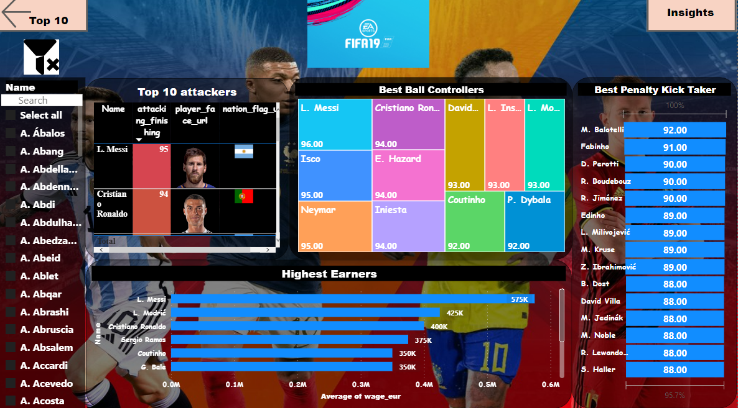
6. Modelling
Data Modelling is the process of analyzing the data objects and their relationship to the other objects. It is used to analyze the data requirements that are required for the business processes. The data models are created to store the data in a database. The Data Model's main focus is on what data is needed and how we have to organize data rather than what operations we have to perform.
7. Deployment
Dashboard created on Power Bi

